Slide 1
Flood Monitoring and early warning system:
Floods are amongst the most common and devastating of all natural hazards. The alarming number of flood-related deaths and financial losses suffered annually across the world call for improved response to flood risks. Interestingly, the last decade has presented great opportunities with a series of scholarly activities exploring how camera images and wireless sensor data from Internet-of-Things (IoT) networks can improve flood management. This paper presents a systematic review of the literature regarding IoT-based sensors and computer vision applications in flood monitoring and mapping. The paper contributes by highlighting the main computer vision techniques and IoT sensor approaches utilised in the literature for real-time flood monitoring, flood modelling, mapping and early warning systems including the estimation of water level. The paper further contributes by providing recommendations for future research. In particular, the study recommends ways in which computer vision and IoT sensor techniques can be harnessed to better monitor and manage coastal lagoons—an aspect that is under-explored in the literature.

Slide 2
1.Introduction:
Natural hazards such as floods,storms,tsunamis and others pose a significant threat to lives and property around the world. Without proper monitoring and effective mitigation measures, these natural perils often culminate in disasters that have severe implications in terms of economic loss, social disruptions and damage to the urban environment. Historical records have shown that flood is the most frequent natural hazard,accounting for 41% of all natural perils that occurred globally in the last decade. In this period alone (2009 to 2019), there were over 1566 flood occurrences affecting 0.754 billion people around the world with 51,002 deaths recorded and damage estimated at $371.8 billion.

Slide 3
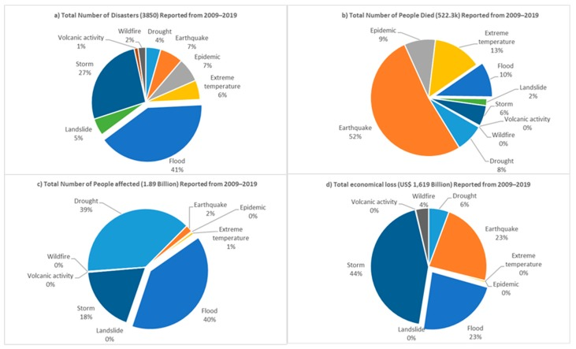
Comparison of different disaster types reported from 2009 to 2019: (a) total number of reported disasters; (b) total number of deaths (c) total number of people affected; (d) total economic loss

Slide 4
Significant efforts have been made globally to develop cost-effective and robust flood monitoring solutions. A common approach is based on computer vision, wherein relevant images from existing urban surveillance cameras are captured and processed to improve decision making about floods. These types of camera-based applications involve low equipment cost and wide aerial coverage thereby enabling the detection of flood levels at multiple points. The wider coverage gives the computer vision approach an advantage over the traditional flood monitoring method that relies on fixed-point sensors. Computer vision is based on image processing techniques that have been widely applied in many fields, including aerospace, medicine, traffic monitoring, and environmental object analysis. In the last decade, research efforts have intensified in exploring computer vision to improve flood monitoring, flood inundation mapping, debris flow estimation, and post-flood damage estimation. To effectively harness this knowledge and foster rapid research progress, it is important to review the relevant literature and provide a constructively critical appraisal of scientific production, including recommended directions for future research.

Slide 5
Another method of flood monitoring and prediction is the use of wireless sensors powered by the Internet of Things (IoT) technology. IoT and computational models such as artificial neural network (ANNs) have opened up new doorways, allowing the design of new hardware and software to provide real-time water-level data as required for flood monitoring and forecasting. Today, many flood-prone countries, including the tropical nation of Indonesia that suffers from annual monsoonal rainfall, are exploring IoT sensors to gather intelligence for issuing early warnings and evacuate orders to people at risk of major floods.The IoT has gained increased popularity in the last decade, particularly within the context of smart city applications such as real-time monitoring of urban drainage networks using wireless sensors. A review of the relevant literature is needed to provide an in-depth understanding of the research scope and progress achieved in the last decade of using IoT sensors for flood monitoring in both occupied lands and other coastal sites such as lakes and lagoons.

Slide 6
This study provides an opportunity to update readers on recent advancements in flood monitoring, and how technology is used in the literature to map the flood events. The motivation behind this study is to highlight existing solutions and adapt them to better manage coastal lagoons, which impose flood threat to the local communities. This study presents a systematic review of the literature focusing on the use of computer vision and IoT-based sensors in flood monitoring, mapping and prediction for both occupied lands and coastal sites such as lagoons. The main contributions of this article are as follows:
A detailed survey is presented on the use of computer vision and IoT-based sensors for flood monitoring and early warning system. The scope covers the state of the art applications of computer vision and sensor integrated approaches for managing coastal sites and other flood-prone urban areas.
The study highlights gaps in the literature and recommends directions for future research.
The following section presents the methodology adopted in conducting this systematic literature review.

Slide 7
2. Methodology:
This section provide details for the procedure involved in the selection,inclusion and exclusion of research articles. The review was conducted using the Preferred Reporting Items for Systematic Reviews and Meta-Analysis (PRISMA) guidelines. Overall, three databases were selected to conduct this review, namely,Scopus,IEEE,Xplore and Science Direct. The keywords utilised to select relevant articles from the databases are listed below along with the number of retrieved research papers.

Slide 8
Keyword | Scopus | IEEE Xplore | Science Direct
“remote sensing AND lagoon” | 229 | 4 | 525
“remote sensing AND flood” | 3022 | 871 | 452
“IoT AND flood” | 48 | 58 | 921
“UAV AND flood” | 109 | 36 | 521
“drones AND flood” | 19 | 8 | 689
“computer vision AND flood” | 40 | 58 | 792
“computer vision AND coastal” | 30 | 52 | 1076
“wireless sensor network AND flood” | 300 | 1255 | 2760
Total | 3797 | 2342 | 7736

Slide 9
The research articles were manually screened by reading the title and abstract. The database search returned (n = 13,875) records from three online databases. After removal of duplicate articles, only 2823 articles were left for review. The titles and abstracts of these 2823 articles were manually screened for relevance, resulting in the exclusion of 2415 records. The remaining 408 articles were selected for full-text review and content analysis. For inclusion in the final list, articles were required to be published between 2009 and 2019 and to be related to flood monitoring, forecasting or mapping. These inclusion criteria resulted in 91 relevant articles. In regard to exclusion criteria, the articles about IoT protocols in flood monitoring were not included in this review, as this is not the core focus of this study. Furthermore, duplicated articles in different databases were also discarded, and only the articles written in English were considered in this review.

Slide 10
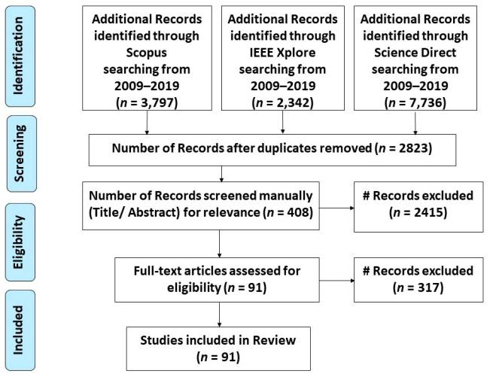
PRISMA flow diagram for the literature review

Slide 11
3. Computer Vision and IoT Sensors for Early Warning Systems:
Remote sensing technologies, such as computer vision and wireless sensor networks (WSNs), are increasingly used in the literature to support early warning systems. An early warning system provides advanced warnings in case the water level is likely to rise and reach the alarming flood level. These systems can generate notifications via SMS alerts, emails or through a web server. An early warning system can, for example, help to send alerts or warnings to local occupants and motorists so that they can avoid the usage of flooded roads. This section will focus on studies that have utilized computer vision and IoT-based sensors for improving early-warning initiatives. This discussion covers several research areas that are useful for supporting early warning systems, including the estimation of water levels through camera images, IoT-based sensor approaches for water level estimation and the use of computer vision for the collection of flood-related data.

Slide 12
Computer Vision for Estimating the Water Level:
The monitoring of water levels is of extreme importance in early warning systems, and computer vision has shown to be useful.Image filtration in computer vision plays a vital role in estimating water levels. For example, Yu et al. proposed the differencing image technique to track and detect minor changes in water level. The difference method is based on analysing the region of interest (ROI) between the previous and current frame and then outputting a level of water by using the Otsu threshold method. The acquired image from the river is first filtered by using a Gaussian and averaging filter that helps to minimize the noise. The water level is then estimated from the y-axis of the edged image. The experiment was performed in only one location. Given that a threshold for the different filters will change under different illuminations, it will be interesting to investigate the robustness of this approach by conducting the experiment in different locations. A similar approach to the differencing technique has been proposed by Hiroi et al. The proposed remote sensing solution also utilises the differencing technique to observe water levels via cameras.

Slide 13
However, this approach involves taking images at 10 min intervals, comparing every successive image with the last reading and then estimating the water level by using logistic regression. The solution was successfully tested on 13 different locations, reliably predicting a rise in water level with decent accuracy
Another study utilised the physical measuring ruler along with different computational models in computer vision, including the differencing method,dictionary learning and convolutional neural network (CNNs). The dictionary method is based on classifying the ROI into two classes, i.e., ruler and water region.
The features of the water and ruler are stored in the dictionary. By analysing the boundary line between the ruler and water classes, the water level can be calculated. The CNN delivered the most promising results. A CNN is a computer vision technique which involves convolving the image with the filter. The role of the filter is to extract important features from the image. The algorithm was trained on raw images and during prediction. Instead of using preserved features from the dictionary, the algorithm extracted features from the input image. Having tested the algorithms on six different locations, the study concluded that the CNN outperformed the accuracy of both the dictionary learning technique and the differencing method.

Slide 14
Comparison of the average and variance of error for different computer vision techniques:
Method | Average Error (m) | Variance of Error (m²)
Difference Technique | 0.046 | 0.003
Dictionary Learning | 0.023 | 2.636 × 10⁻⁴
Convolutional Neural Network (CNN) | 0.009 | 4.476 × 10⁻⁵

Slide 15
IoT – Based Sensors Sensors for Estimating Water Level:
There are several available sensors which are useful for estimating water level and thus improving early warning systems. The first type of sensor is a pressure transducer. Automatic pressure transducers can measure up to some 0.001m accracy in water level and are compatible with many of the controllers for logging data or visualising data in real time. On the downside, automatic pressure transducers require calibration and are highly sensitive to any vertical displacement from the point of installation,as this can potentially degrade the accuracy of water level measurement as a result of changes in hydrostatic pressure.
Additional sensors may be required for air pressure monitoring to adjust the output of pressure transducers. Rangefinder sensors can be a great option, but these devices are often non-submersible. Rangefinder sensors are low-cost devices which makes them affordable, particularly when several sensor nodes are required to monitor a large area. However, rangefinder sensors also require manual calibration and are dependent on the distance from the measurable water level. In that sense, rangefinder sensors are popular when it comes to finding the distance from an object. Essentially, ultrasonic/rangefinder sensors transmit a signal and calculate the time in between the send and receive signals as in the case of water level monitoring.
Similarly, optical and radar sensors play a vital role in flood monitoring and assessment through satellites.

Slide 16
An early flood detection system can be implemented through real-time monitoring of the flood-prone area via sensors deployed in optimal locations at the site. This approach provides a convenient and cost-effective way to monitor flood-prone sites in real time. Furthermore, Thekkil and Balaji utilised ZigBee and Global System for Mobile (GSM) to transmit acquired camera images and generate flood-related warnings. The study also utilised the scale-invariant feature transform (SIFT) algorithm for the autonomous monitoring of flood. In a similar approach, Pratama utilised Mamdani fuzzy logic along with ZigBee and water level sensors to detect and transmit the flood-related data. The study suggests that the maximum error for the proposed approach falls within an acceptable range of five percent. Waleed proposed a microchip-based solution using an array of piezoelectric pressure sensors that measure the pressure exerted by water and ZigBee for transmitting and receiving the data. The sensors were prototyped on Altera’s Cyclone board. The study also suggested that placement of the sensors is of extreme importance to forecast flood accurately. Ogie proposed a solution for the best placement of water-level sensors. The study puts a considerable emphasis on the optimal placement of the sensors, as it is important to gain situational awareness of water level in a large area of interest. The NSGA-II algorithm, which has gained wide application in many real-world problems, was used to find the best spot for the sensors. Using the sensor placement algorithm, four locally fabricated sensors were deployed to monitor water levels at different points in the waterways in Jakarta, Indonesia.

Slide 17
Monitoring of water level has stirred the design and implementation of several wireless sensor networks(WSNs). The study was executed to monitor and control the distribution substation in low-lying areas, providing early warning to the local community in case the water level increases above a predefined threshold value. Other similar studies have provided real time signals from a WSN to inform an early warning system. These studies have mostly relied on a web server to visualise the data coming from the flood monitoring station.
Additionally, Jayashree proposed an early warning system based on real-time monitoring of dams via flow and water level sensors. The data collected from sensors is accessible and available to the public and can be fetched through an Android app designed for the research. Similarly, Teixidó and Smith presented a WSN system to notify the user in case of flooding. Similarly, Yumang designed a sensor network system capable of issuing warnings to locals in the event of flooding. The proposed system is based on sensors to monitor water level, a renewable power source to power the system and a GSM shield to transmit data.

Slide 18
Analysis of IoT- based sensors are listed below:
Proposed Method |  | Proposed method | Focus
A (sensors available to forecast flood) |  | Pressure transducer and radar sensor | Discussed the pros and cons of the pressure transducer and rangefinder sensors in estimating water level
 |  | Optical and radar sensors | Comparison between optical and radar sensor for acquiring both time series and visual information
 |  | Multilayer Perceptron (MLP) algorithm, along with soil moisture and CO₂ sensors. | Forecasting of the flash flood by utilizing soil moisture and CO₂ sensors
 |  | Unmanned Aerial Vehicle (UAV) deployment of disposable sensors | One-time deployment of sensors to study the flow of river and forecast flooding
 |  | Webserver for visualization of data | Forecasting of the flood by via remote sensing
 |  | Internet of Things (IoT) protocols and commercial sensors | IoT for disaster management

Slide 19
B (IoT-based sensors and early warning system) |  | NodeMCU and ultrasonic sensor along with Blynk platform | Monitoring of water level in real-time via cell phone application powered by Blynk
 |  | EnOcean and ultrasonic sensors | A cost-effective approach to deploy water level sensors
 |  | Rangefinder, humidity, CO₂ and Global Positioning System (GPS) sensors | Early warning system based on off-the-shelf sensors
 |  | Precipitation and ultrasonic sensor along with utilizing network parameters to reduce power consumption | Power-efficient approach in WSN
 |  | SIFT algorithm along with the camera, ZigBee and Global System For Mobile (GSM) | Early warning system based on ZigBee and GSM
 |  | Mamdani fuzzy logic, ZigBee and water level sensor | Forecast flooding based on Fuzzy logic
 |  | Piezoelectric pressure sensors, Altera’s Cyclone board and ZigBee | Early warning system based on ZigBee
 |  | NSGS-II algorithm | Best spot for the WSN to get the best coverage of the site
 |  | Water level sensor, Analog to Digital Converter (ADC), 8051 microprocessor and ZigBee to monitor the water level | Monitor and control of distribution substation in low-lying areas, and issue early warnings in case of water overflow
 |  | Flow, water level and ZigBee | Early warning system based on real-time monitoring of dams
 |  | Low-power wireless sensor network (WSN) | Early warning system based on WSN
 |  | Water level sensor, Global System For Mobile (GSM) and renewable power source | Water level monitoring over cellular Communications
 |  | Wireless sensor network (WSN) | Early warning system based on WSN
 |  | IoT Device, GSM | Sensor for River water level monitoring over cellular communications

Slide 20
